Slide 1
Image Preprocessing
Prepared By: Maimoona Akram

Slide 2
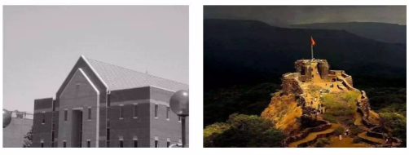
Image
An image is a spatial representation of a two- or three-dimensional scene
An image consists of an array or matrix of pixels organized in rows and columns

Slide 3
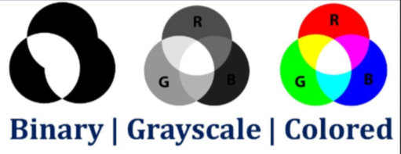
Types of Images
Grayscale
Shades range from black to white, with no color
Useful in medical imaging and photography
RGB
Composed of multiple color channels (Red, Green and Blue)
Binary
Contain only two colors (black and white)
Used in simple pattern recognition and barcodes

Slide 4
Numeric Representation
Pixel values:
Grayscale: 0 (black) to 255 (white)
RGB: (R, G, B) values between 0–255
Data types: uint8, float32

Slide 5
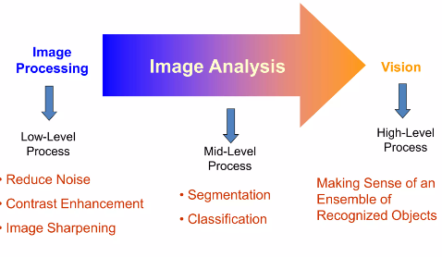
Digital Image Processing

Slide 6
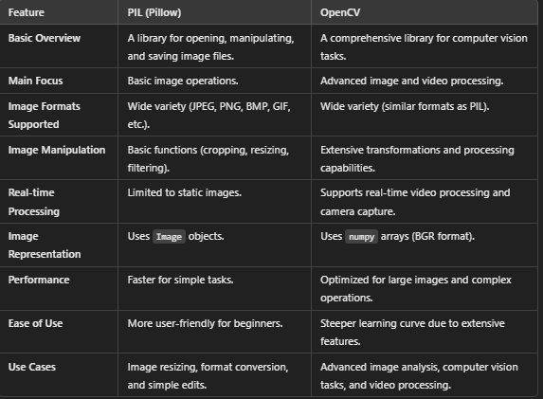
PIL versus OpenCV

Slide 7
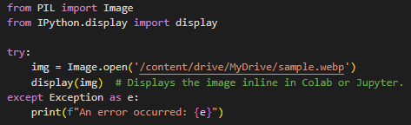
Loading and displaying of image using PIL

Slide 8
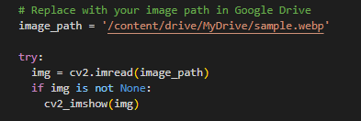
Loading and displaying Image using OpenCV
cv2.imread(): Loads the image
cv2.imshow(): Displays it

Slide 9
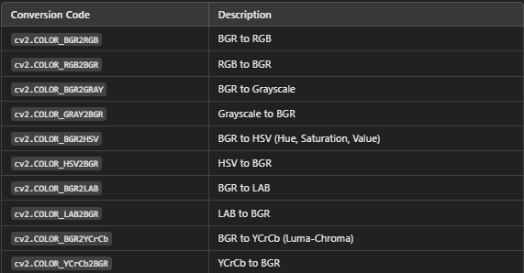
Common Color Conversions in OpenCV cv2.cvtcolor()

Slide 10
Applications of Histograms in Image Manipulation
Histogram Equalization: Enhance contrast by redistributing pixel values more evenly.
Thresholding: Analyze the histogram to find optimal thresholds for binarization.
Color Correction: Use color histograms to detect and correct color imbalances (e.g., a reddish tint).
Noise Detection: If the histogram has a lot of scattered low peaks, the image might contain noise.

Slide 11
Sample for Image Processing using OpenCV and PIL Libraries on Google Colab
The Jupyter notebook is shared on GoogleClassroom

